Slide 1
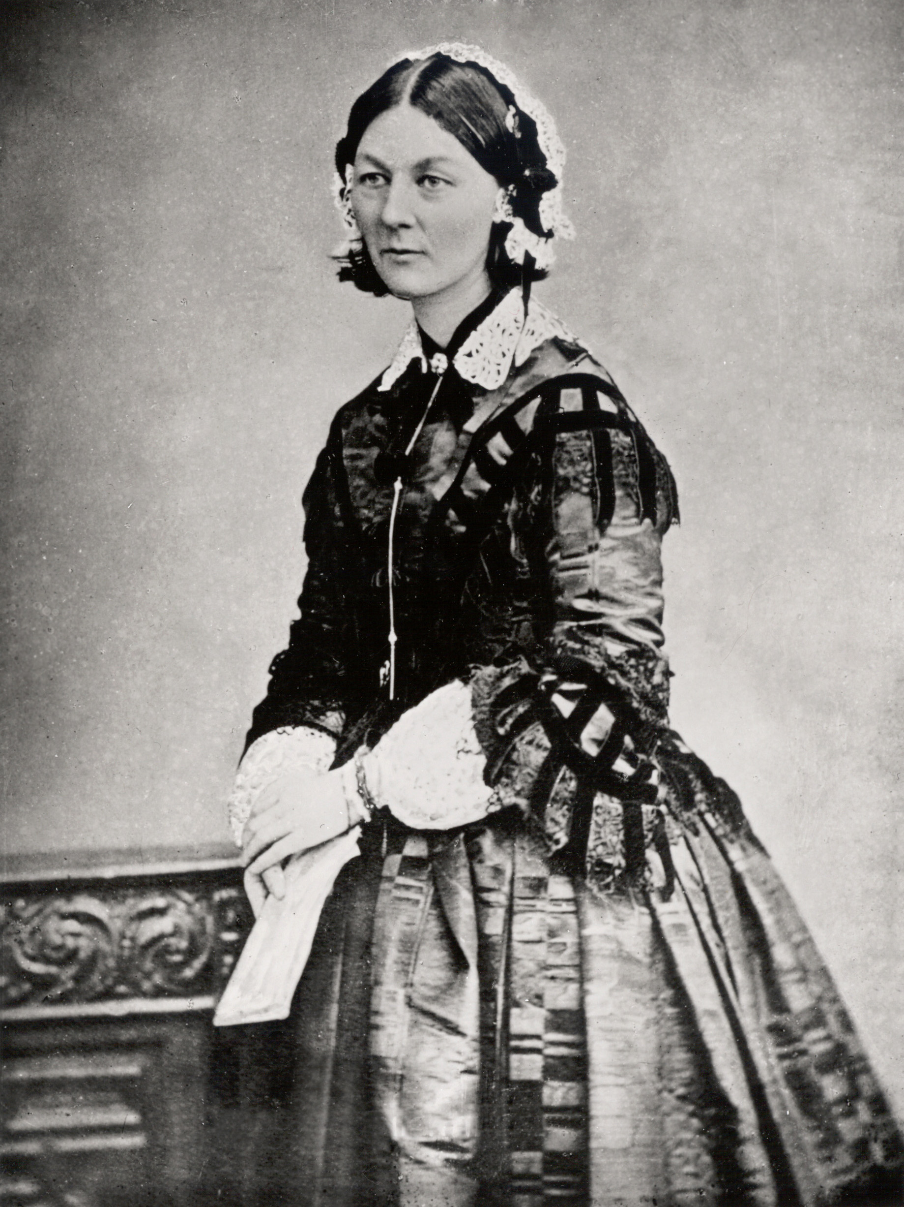


Paving the Way: Women as Mentors and Advocates for Junior Statisticians
WNAR 2021, Florence Nightingale’s 200th Birthday
Jessica Minnier, PhD
June 14, 2021
Notes:
Hello everyone, my name is Jessica Minnier and I’m an associate professor of biostatistics at Oregon Health & Science University. Thanks to Dr. Jahan for inviting me to this informative session.
Today I want to talk about women in statistics, as well as other underrepresented groups, and highlight some statisticians who have paved the way for people of all backgrounds to have fruitful careers in statistics.

Slide 2
Introduction and Inspiration
In 1840, FN begged her parents to study mathematics
Mother: "did not approve, home duties were not to be neglected for mathematics”
Father: loved math, but encouraged study of other subjects (history or philosophy); though encouraged education of his daughters
Eventually, FN was allowed to have tutors in mathematics (arithmetic, geometry, algebra), and later tutored children in these subjects and showed concern about education of girls in math
Who inspires us, and has paved our way?
Florence Nightingale, Amstat Magazine 22-Sept-2016
Notes:
So the inspiration for this talk in this session, is that of course Florence NIghtingale herself continues to inspire women to study statistics and nursing through her story and her success as a leader in nursing and statistics. Also through the trailblazing path she created through a primarily white male centered field of mathematics, and her work to professionalize the nursing field. But as a young woman in Victorian era England, she had to overcome many barriers to get to where she ended up. As a child her father was fairly liberal in comparison to his peers and taught his daughters many subjects, including some science and mathematics. As a young adult, she begged her parents to let her study mathematics more formally. Her parents did not approve, and instead tried to steer her toward more womanly areas of study, and suggested she shouldn’t neglect household duties. But eventually she won the argument, and she was able to study mathematics and later she became a tutor herself of children, and she seemed especially concerned with making sure the young girls knew some mathematics. So while these efforts seem highly restricted these days, it was the beginning of exposing young women to fields and careers that were previously not accessible to them. In the rest of the talk I want to highlight examples of other mentors and trailblazing statisticans throughout history.

Slide 3
Mentorship
Traditionally defined as when a more senior person advises a junior person in their career
Has wider repercussions on who enters our field and who stays
In the context of progression of our field, sometimes requires advocating for institutional change and culture shifts
Representation Matters
Seeing examples of people “like us” in statistics field helps us to believe in our own abilities, and belonging
We all need role models
3
Notes:
In terms of mentorship, I think we all know why mentorship is important to help people grow in their careers and find opportunities they might not have known about. But it’s also important to remember that mentorship may not be enough if there are institutional or culture barriers that prevent some people from succeeding in statistics. To improve access to our field, we especially need the well established members of our field to fight for institutional change, and also we need to foster representation and make sure that people of underrepresented groups succeed so that young people have role models and can see themselves belonging in the statistical community as well.

Slide 4
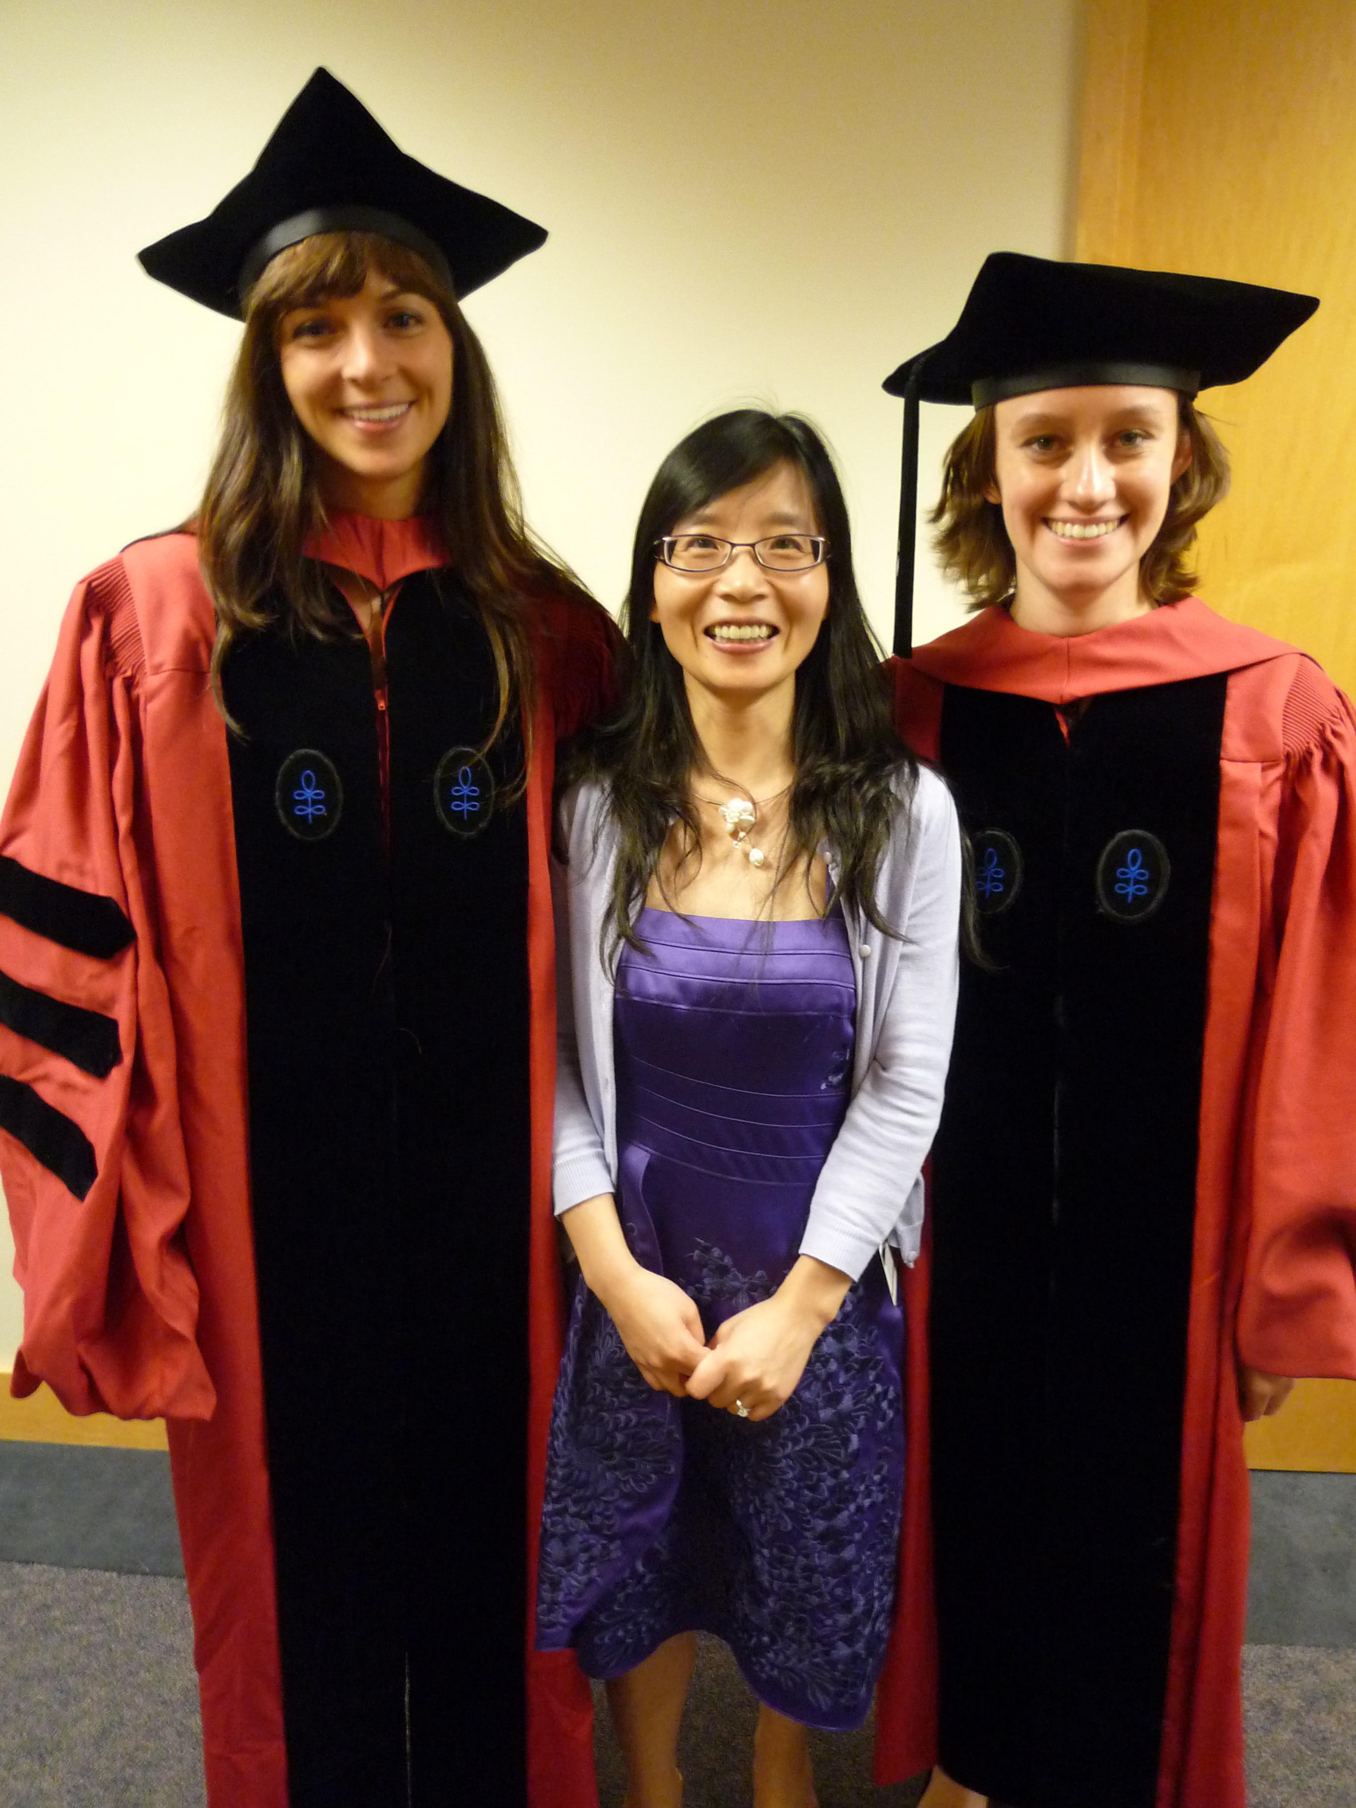
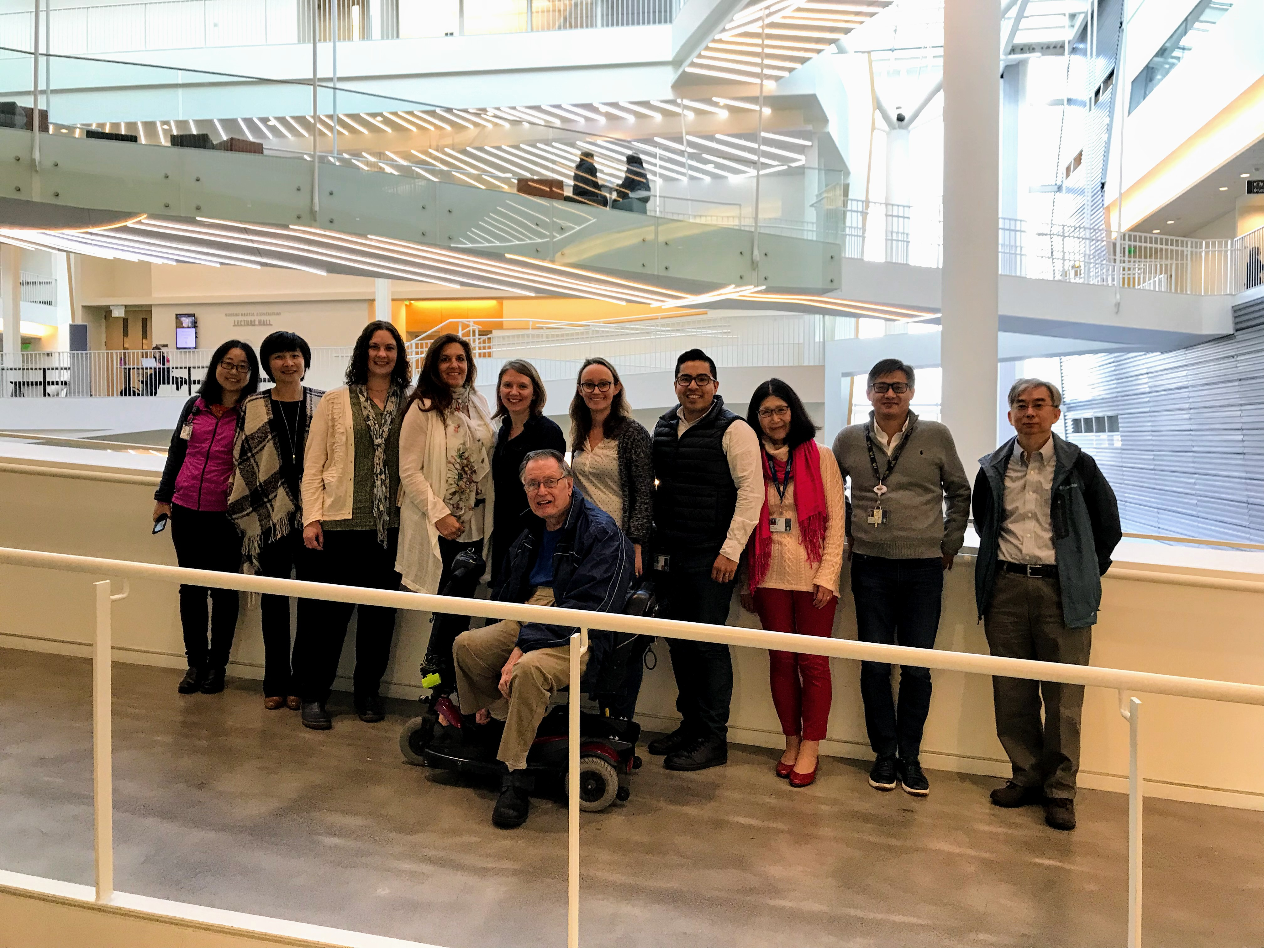
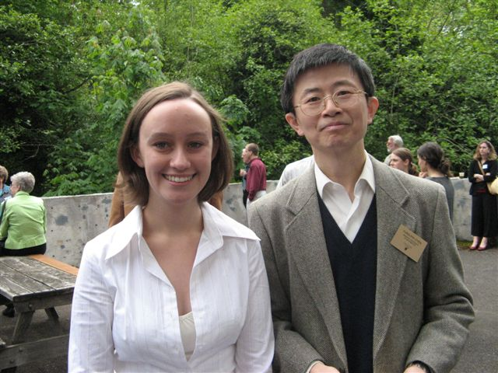
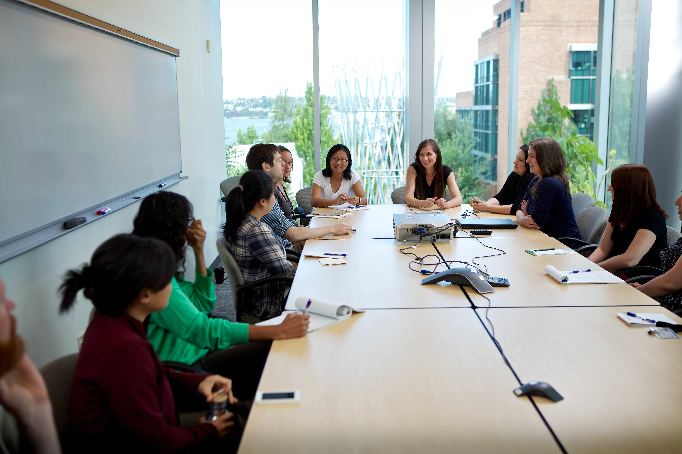
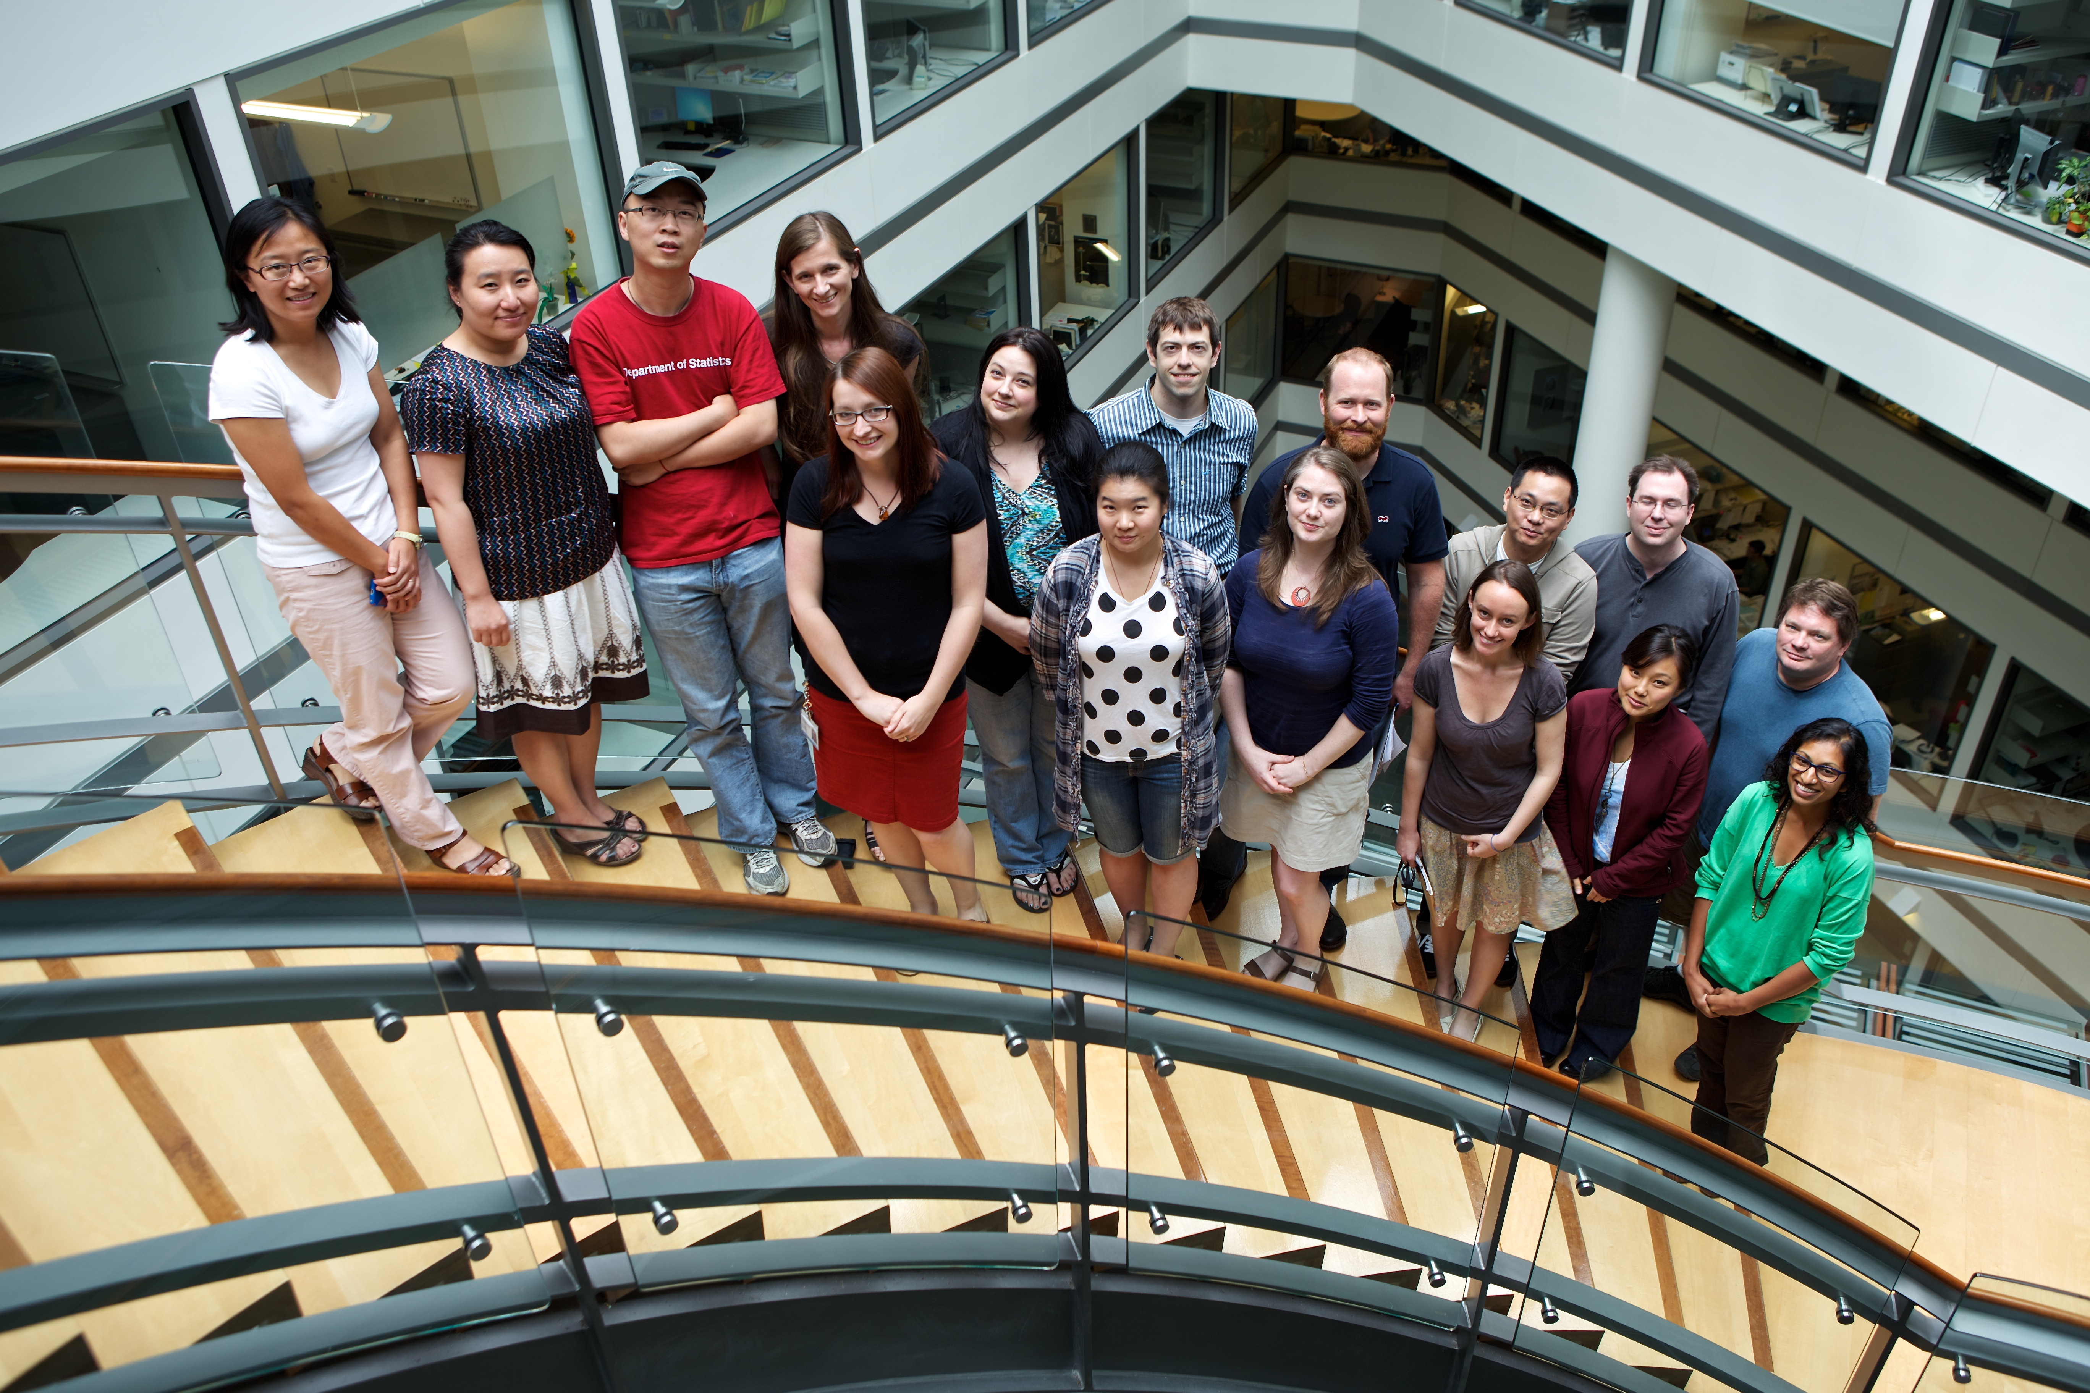
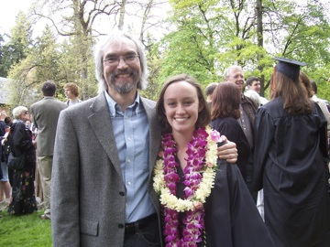
First, my own journey
High School, Algebra 1 with Spencer Kellogg
Lewis & Clark College, Math/CS Dept
Harvard SPH
Fred Hutch
OHSU
Notes:
To begin, I felt that I needed to use this oopportunity to give a brief mention to some mentors in my life that have helped me get too where I am today. My first inkling that I would enjoy doing something with mathematics in my career was in high school when my Algebra teacher Mr. Kellogg encouraged me to keep going with mathematics and he believed I would go far with it. In college, I majored in math and was inspired by all of my professors, including my advisor Dr. Chen who was a statistician and guided me in my first research projects.
In my PhD program, my advisor Dr. Tianxi Cai was a young superstar statistician who has continued long after graduation to guide me in my career and find opportunities for me and the rest of her mentees. She is the smartest person I know but always believed that we could succeed in whatever task we put our minds to.
After grad school when I was at the Hutch, I was especially inspired by two women who were long time powerhouse collaborators, Dr. Li Hsu and Dr. Riki Peters. Dr. Peters and Dr. Li showed me how effective successful collaboration could be, how to lead a large team of people, and also how to influence science and medicine with good research and hard work. And finally, at OHSU I’ve been lucky to have several female leaders in our department who have helped me find my way in my first years as professor and repeatedly spoke up to leadership to open doors for me and make sure we all are treated fairly, especially Dr. Tomi Mori who suggested me as a speaker for this session, yet another opportunity she sent my way.

Slide 5
F.N. Paves the Way
Tutored children in mathematics, especially young girls
Set up Nightingale Fund and the Nightingale Training School for nurses, establishing professionalism of the field
In the 1870s, mentored Linda Richards, “America’s first trained nurse” who returned to the U.S. and established high-quality nursing schools
Wikipedia, and references therein
5
Notes:
So back to Florence Nightingale. As I mentioned, she was instrumental in establishing professionalism of the field of nursing, and her mentees went on to further the field. One woman, Linda Richards, is considered America’s first trained nurse and she went on to the US to establish high quality-nursing schools. So it’s difficult to quantify the far reaching effects of Florence Nightingale’s mentorship as it has trickled down exponentially I’m sure.

Slide 6
F.N. Paves the Way
Progressive for Victorian era, but there have been some criticisms
“Nightingale believed that women craved sympathy and were not as capable as men.”
“Criticized early women's rights activists for decrying an alleged lack of careers for women at the same time that lucrative medical positions, under the supervision of Nightingale and others, went perpetually unfilled.”
She often referred to herself in the masculine, as for example "a man of action" and "a man of business".
Wikipedia, and references therein
6
Notes:
I will note that in reading some histories, there has been a bit of criticism that Florence Nightingale could have done more for women, that she could have hired more women into high profile positions and so on. Some of her attitudes about women’s abilities and temperaments were definitely a bit closed minded. But I think this is more a product of the era she lived in, and it’s easy for us to criticize what she could have and should have done. As we know, it has been a difficult road for women and underrepresented minority groups to get their foot in the door especially in fields of science and mathematics.

Slide 7
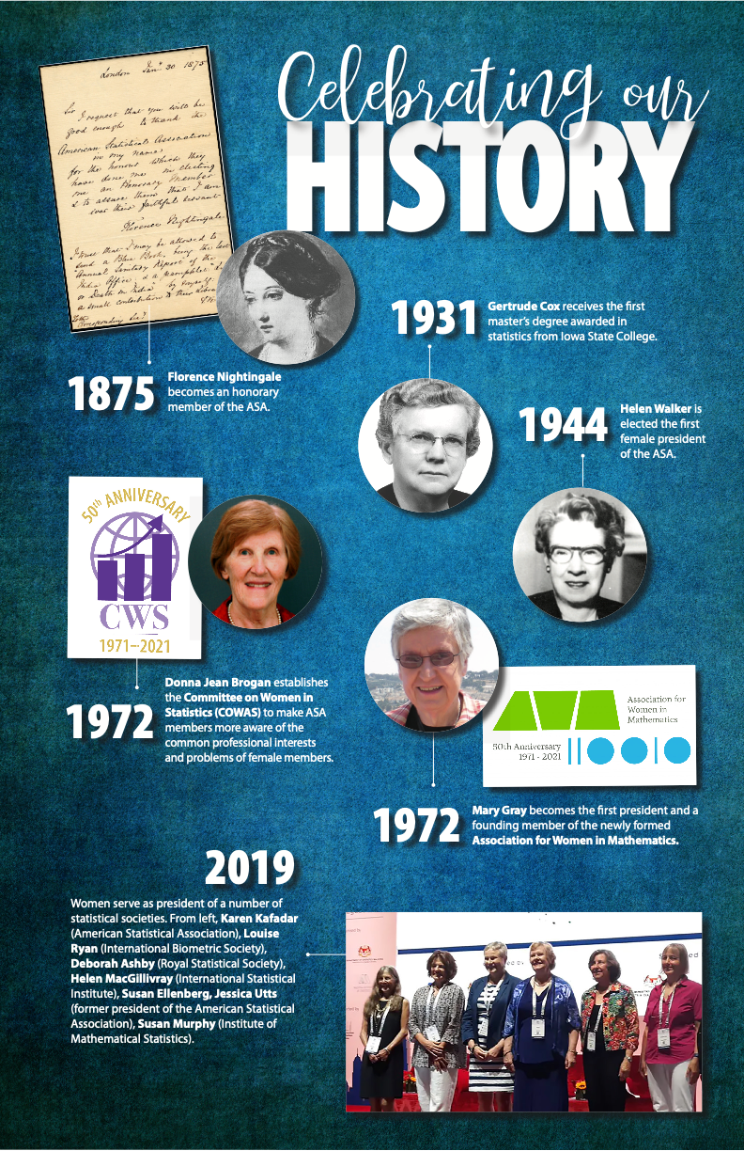
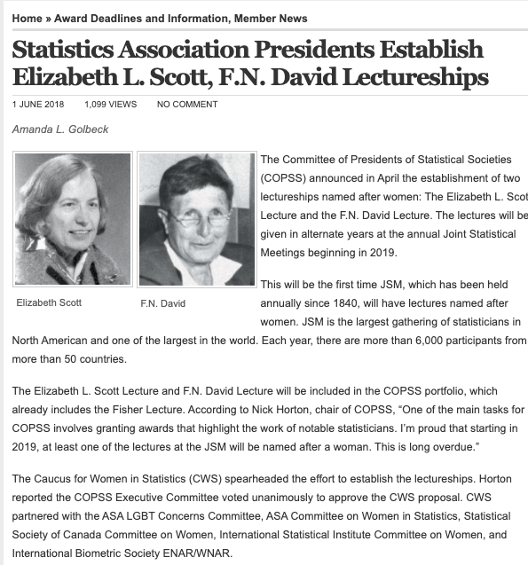
Notes:
But overall in context of the times, we know that Florence NIghtingale’s career overall helped pave the way for future women to make headway in statistics. Though it took many decades for women to be recognized professionally, and also for the field of statistics to mature. In 1931, Gertrude Cox received the first master’s degree awarded in statistics, and in 1944 Helen Walker was elected as the first female president of the ASA. There have since been several committees and associations focused on women in statistics. In the early 1970s, the Commitee on Women in Statistics in ASA, and the Caucus for Women in Statistics, as well as the Association for Women in Mathematics were founded. At that time, several other major statistical associations, including ISI and IMS, had never seen a woman president. Much more recently, we’ve had the inaugural Women in Statistics Conference in 2014 which has since become the women in statistics and data science conference I believe. There have been several awards established, including the Gertrude M. Cox Scholarship, the Florence Nightingale David Award and lectureship, and the Elizabeth L Scott Award and lectureship. The first time the lectureships named after women were given at JSM was just a couple years ago in 2019. So obviously it has been a long and gradual progression. Also, this slide doesn’t address at all the contributions of newly formed committees for increasing diversity in race, ethnicity, and gender, and I believe we still have a long way to go to become a fully inclusive field.

Slide 8
Mentorship Awards
Elizabeth L. Scott Award This award recognizes an individual who exemplifies the contributions of Elizabeth L. Scott’s lifelong efforts to further the careers of women in academia. The award is granted to an individual, male or female, who has helped foster opportunities in statistics for women.
Florence Nightingale David Award: In the spirit of F. N. David, the award is presented to a female statistician who has advanced the discipline and proven herself to be an outstanding role model. She shall have demonstrated excellence and leadership.
The Jeanne E. Griffith Mentoring Award was established in 2002 as a tribute to Jeanne Griffith’s work of more than 25 years in the federal statistical system. The award is meant to encourage mentoring of junior statisticians in federal, state, or local government.
Notes:
I want to point out some of the mentorship awards that have been established, to keep in mind when thinking of your own mentors. The first is the Elizabeth L Scott award, which recognizes Elizabeth Scott’s lifelong efforts to further the careers of women in academia. Florence NIghtingale David, who was named after Florence Nightingale, was the first awardee of the Scott award, and later an award was named in her honor, which is presented to a female statistician who has advanced the discipline and proven herself to be an outstanding role model and leader. Lastly, the Jeanne E Griffith mentoring award is focused on leaders in government specifically.

Slide 9
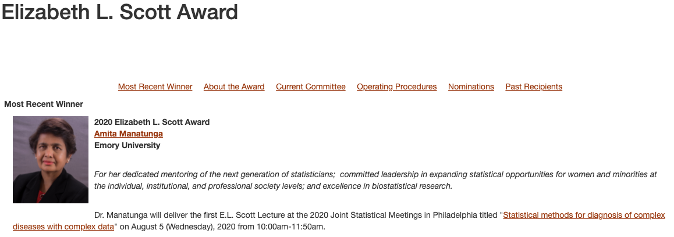
Notes:
The most recent awardee of the Elizabeth L Scott award is Dr. Amita Mantunga, at Emory, for her dedicated mentoring of statisticians and for expanding opportunities for women and minorities in our field. She delivered the lectureship last year.

Slide 10
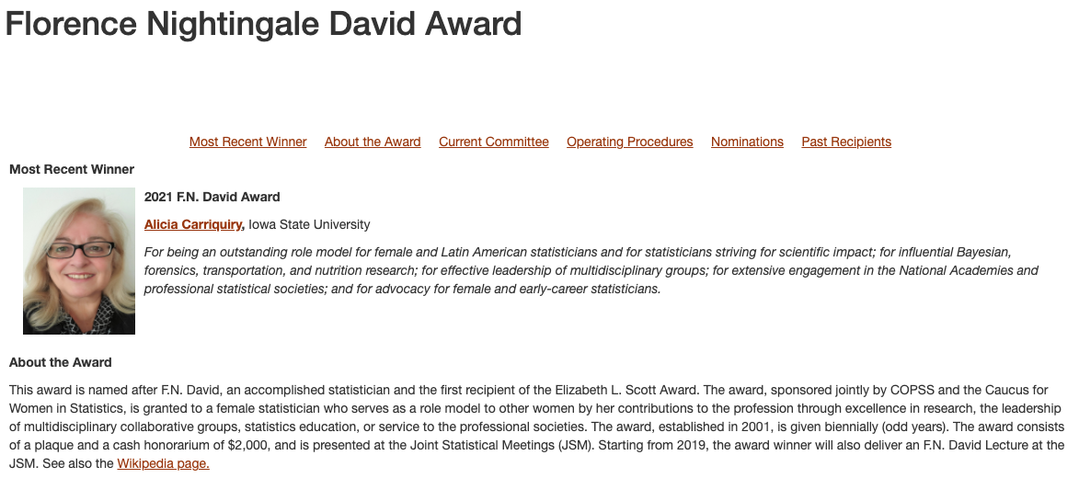
Notes:
The most recent FN David awardee is Dr. Alicia Carriquiry of Iowa state, for being an outstanding role model for female and Latin American statisticians. So it’s wonderful to see these two women representing female statisticians as well as racial and ethnic minorities in leadership and in statistical research.

Slide 11
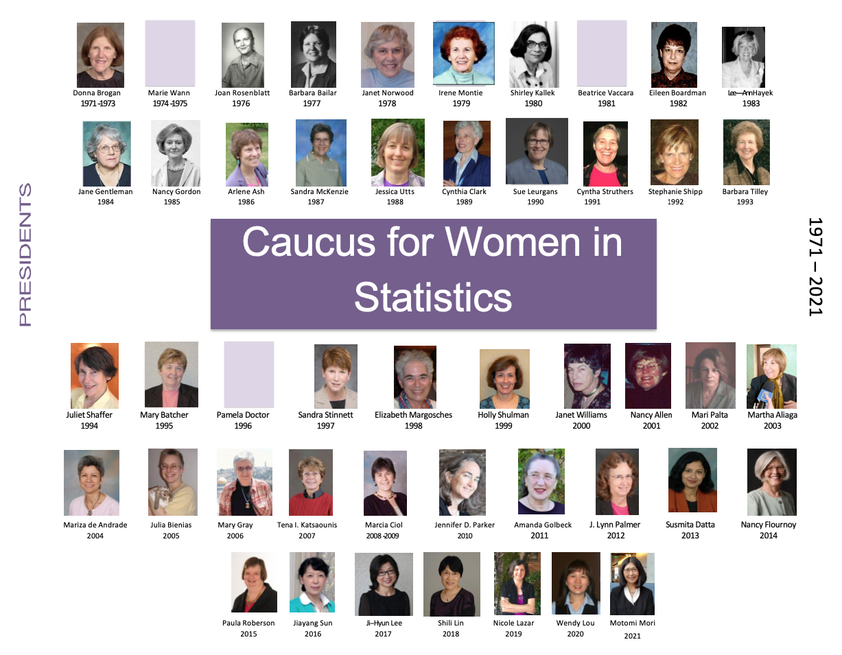
Notes:
I also wanted to show this list of the past presidents of the Caucus for Women in Statistics, with our current president, Tomi Mori who just gave a wonderful talk. It’s refreshing to see a poster like this, when we look at other long lists of presidents in other societies and see mainly white male statisticians dominating the images. I know all of these women have put in a lot of work to further the field, and I’m glad to know a few of them.

Slide 12
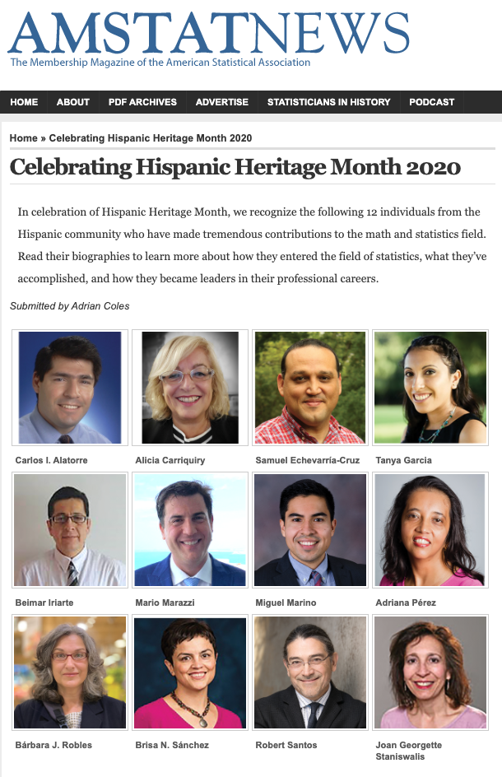
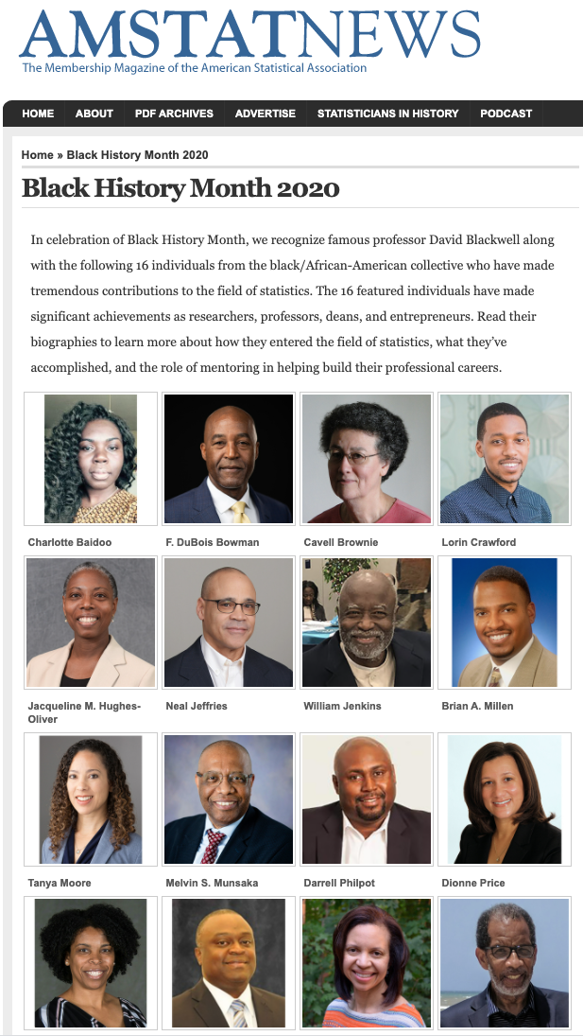
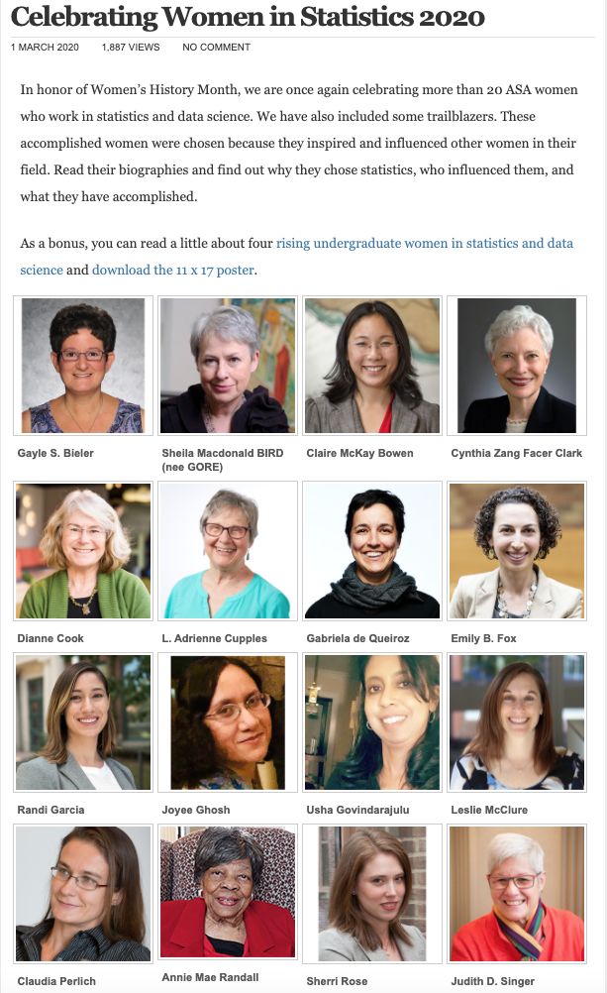
Notes:
In the last several years, the ASA has been highlighting women and people from several underrepresented groups, including black statisticians, hispanic and latino statisticians, and female statisticians. I encourage you to click around on these websites and read the inspiring profiles of all of these people.

Slide 13

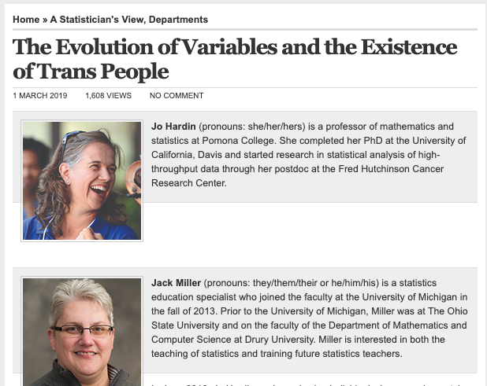
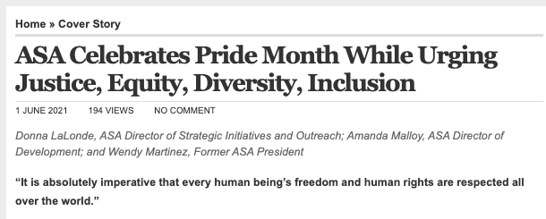
https://magazine.amstat.org/blog/2021/06/01/asa-celebrates-pride-month/
Notes:
The ASA is also celebrating pride month in June, and has had some recent articles highlighting LGBTQ+ statisticians, and the groups that are trying to increase inclusivity and representation in statistics, as well as how we think about gender in statistical analyses. I was hoping they’d have a similar set of profiles like they do for black history and hispanic hertiage months, but maybe that is coming up soon. But in the meantime you should check out the events the ASA is hosting to celebrate pride month this June by looking at their website here.

Slide 14
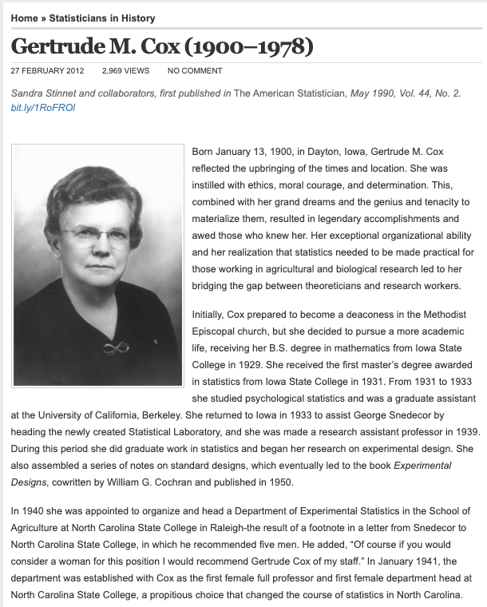
Gertrude Cox
First master’s degree in statistics from Iowa State
First female department head at NC State College
First women elected into the International Statistical Institute
Former president of the American Statistical Association
Notes:
Now I’d like to highlight some statisticians who have been influential in mentoring young women and people from underrepresented groups, as well as those who have been trailblazers breaking those glass ceilings and being the “first woman to do” X. The first person is the famous Gertrude Cox, who actually received the first master’s degree in statistics. But she was also the first female full professor and first female department head at NC State College, was the first women elected into the ISI, and was one of the first women ASA presidents. So she really knocked down a lot of doors in her career in the first half of last century.

Slide 15
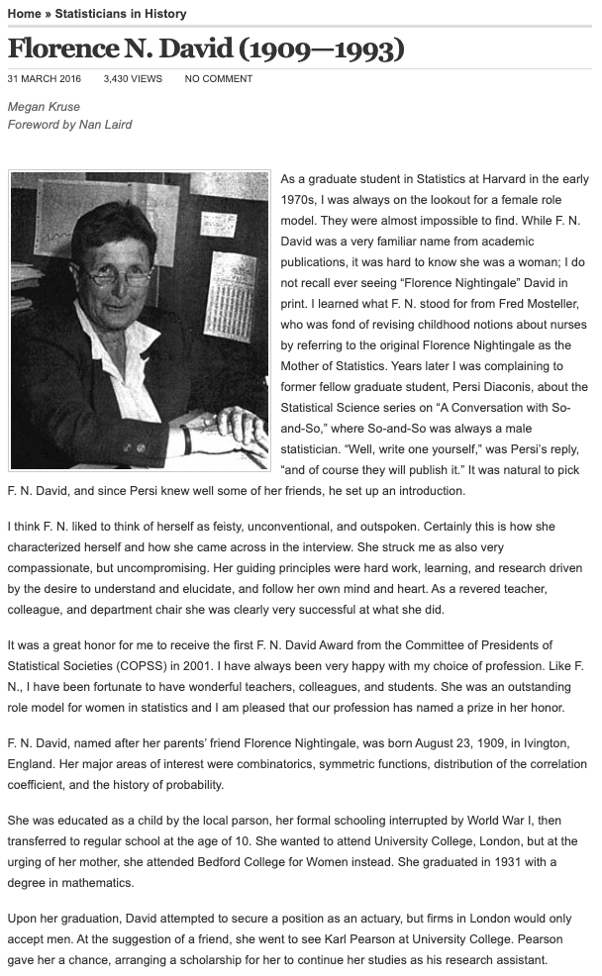
F.N. David
First recipient of the Elizabeth L. Scott Award in 1992
In 2001, COPSS and the Caucus for Women in Statistics established the F. N. David Award. The award is granted to a female statistician who serves as a role model to other women through her contributions to the profession through excellence in research, leadership of multidisciplinary collaborative groups, statistics education, or service to the professional societies.
Notes:
Another famous mentor and important female leader was FN David, where FN stands for Florence Nightingale. She was named after Florence Nightingale as her parents were friends with the original Florence. FN David was the head of the statistics department at UC Riverside in 1970, she was an influential educator and collaborator, and mentored many junior statisticians. She was well known as an excellent role model, and received the first Elizabeth L scott award, and later an award for mentoring was named after her as well, which I described a little bit earlier.

Slide 16
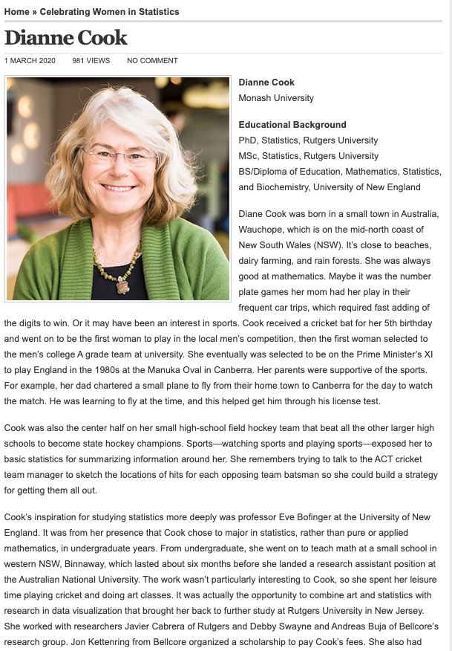
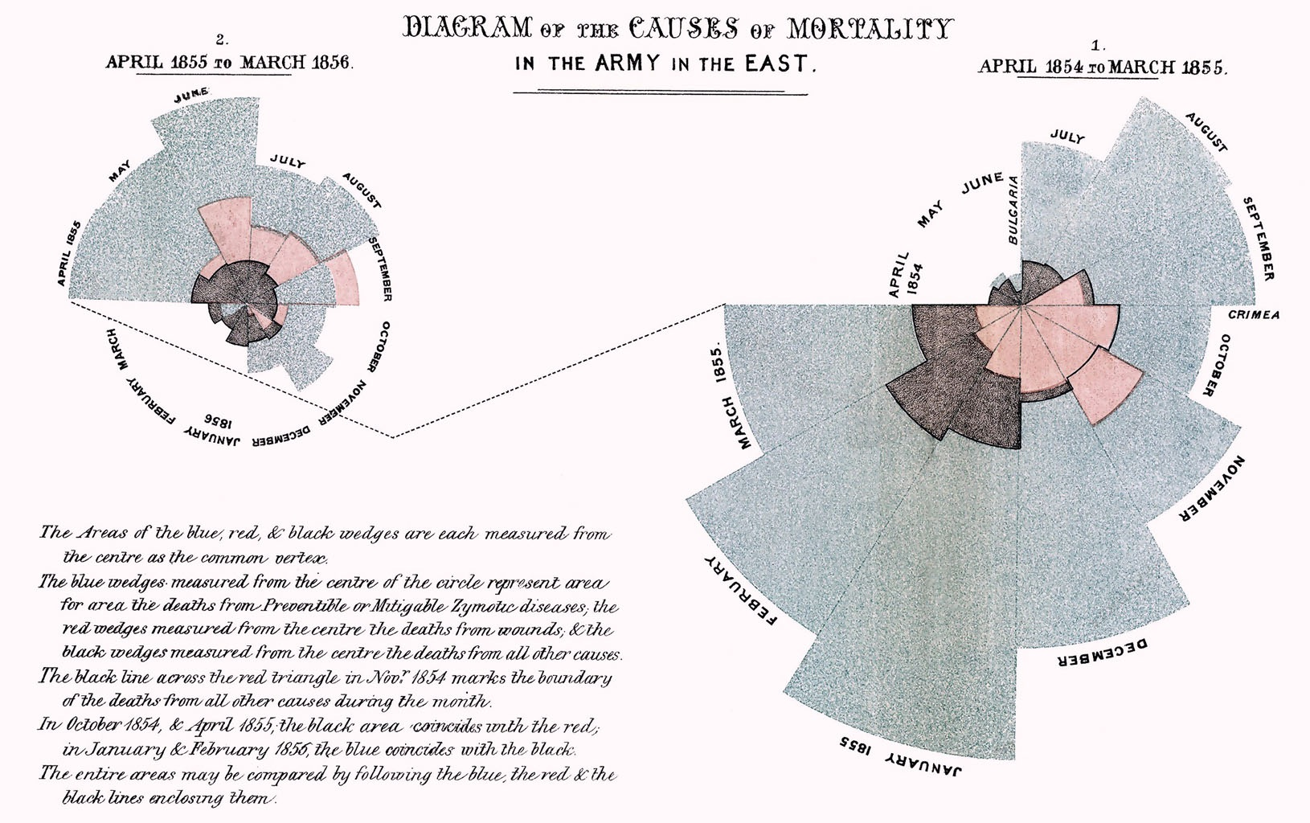
https://www.historyofinformation.com/detail.php?entryid=3815
“In this form, printed tables and all in double columns? I do not think anyone will read it.”
99% Invisible Florence Nightingale Episode
Notes:
And now for a few contemporary leaders in our field. Florence Nightingale was also known for her pioneering use of data visualization. She is credited with inventing the rose plot, which is also called a coxcomb plot, shown here on the left.
This is her rose plot showing the causes of mortality in the Crimean War, where the chart was divided evenly into 12 slices representing months of the year, with the shaded area of each month’s slice proportional to the death rate that month. This actually reminded me of one current female statistician leader, Dr. Di Cook at Monash University in Australia. I’ve seen her give a few excellent talks on data visualization. In her ASA profile, she mentions the many mentors who have helped her career, and she is a notable mentor herself, for example she was a phd advisor to Hadley Wickham who is known for creating many R packages including ggplot, which he started while a grad student under Dr. Cook’s mentorship.
By the way, as an aside, there is an interesting podcast called 99% invisible which had an episode on Florence Nightingale’s data visualizations, which I recommend listening to! They mention that her visualizations have been criticized by some contemporary statisticians, especially because pie charts have been so reviled lately for being misleading and hart to interpret since it is difficult compare across wedges. But they also present a quote of hers that I liked, that is here, “in this form, printed tables and all in double columns? I do not think anyone will read it.” So I think she has a point, there.

Slide 17
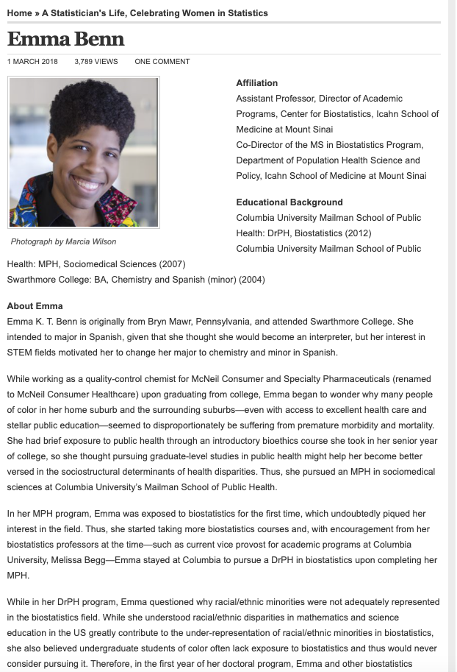
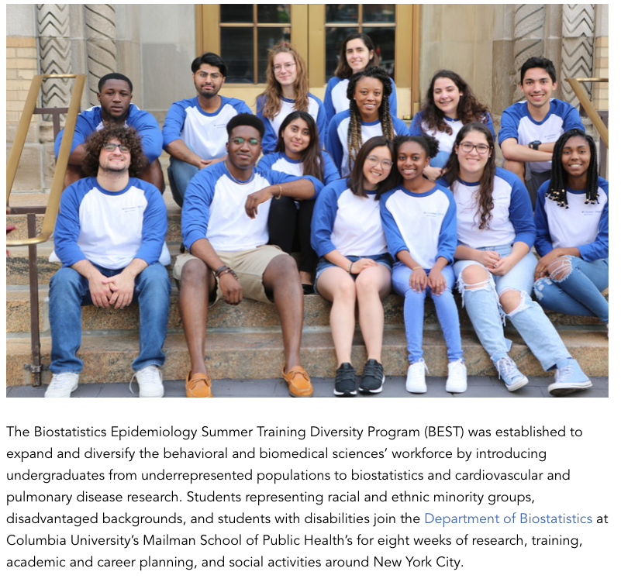
Notes:
Another current inspiring statistician, is Dr. Emma Benn at Columbia. She been inspiring young statisticians from underrepresented populations through a lot of hard work, including founding the BEST Diversity Program. She made an impression on me at the first Women in Statistics conference in 2014, by asking difficult questions to panelists about why so much of feminist movements in statistics focus on white women, especially white heterosexual cisgender women, when we really need to increase representation and visibility of black women and other underrepresented minorities of all genders in our field. In her ASA profile, she says she strives to increase intersectional inclusivity of racial/ethnic minorities, in addition to women and LGBTQ individuals in the fields of statistics and data science, and I believe that she is making great headway in that area with all of her efforts.

Slide 18
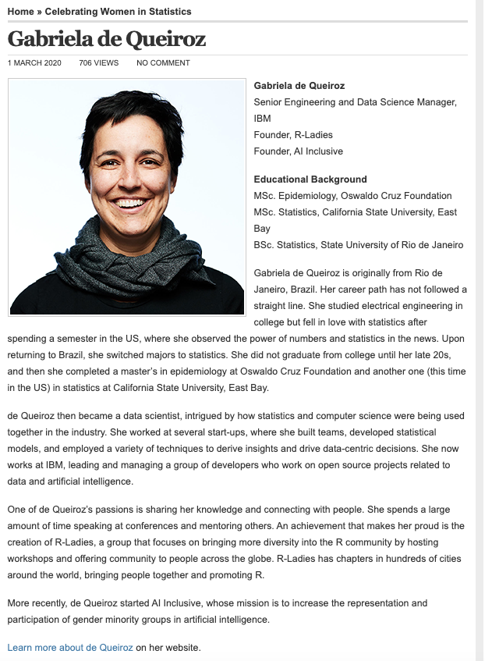
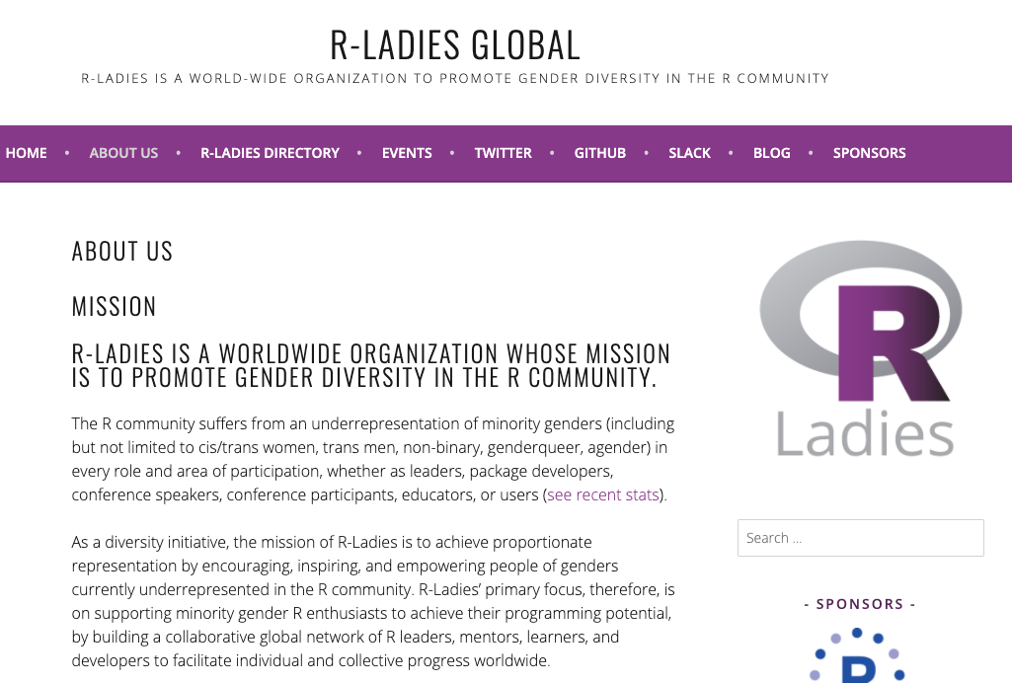
Notes:
Here, we have Dr. Gabi de Queiroz who is an example of a woman making waves in the data science community. She founded the R-Ladies organization several years ago, which has spurred hundreds of chapters across the globe where people of all genders can network and learn R to further their careers. It also has created a network of speakers and mentors that junior data scientists can access. She is at the intersection of statistics and computer science, and is a prominent speaker for inclusivity in data science. She is very generous with her time and has traveled to give talks at many conferences about R-ladies, inspiring many women to join their own local and global data science and statistics communities.

Slide 19
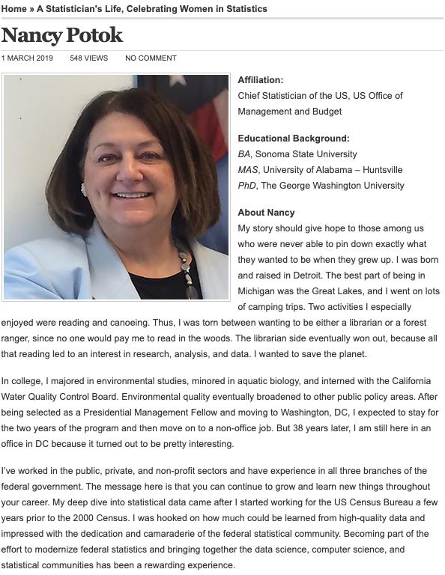
Nancy Potok
“When I first started my career, I was often the only woman in the room. I’ve had a few “firsts” in my career—first program examiner at the Office of Management and Budget to work part time after returning from maternity leave, first female deputy director at the Census Bureau—but times have really changed.”
Notes:
Here this profile is of Dr. Nancy Potok, who was the chief statistcian of the united states a couple yeaars ago, and was before that the first female deputy director of the US Census Bureau. Her profile is interesting because it gives a snapshot of what it has been like to trailblaze through the field of statistics in government roles. She mentions how she was the first woman in her office to return to work after maternity leave and work part time. She says that times have really changed, which is good to hear though I’m sure we still have ways to go.

Slide 20
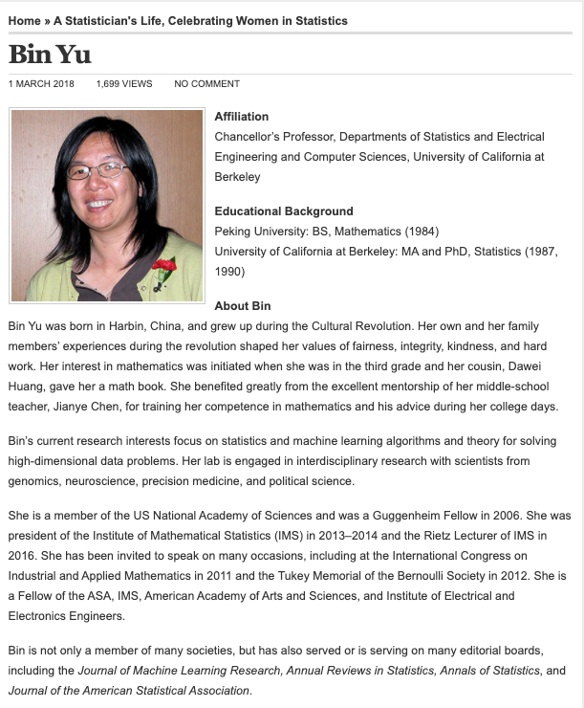
Bin Yu of the University of California, Berkeley is the recipient of the 2018 COPSS Elizabeth L. Award. The citation for Dr. Yu's plaque reads: “For principled leadership in the international scientific community; for commitment and actions towards diversity, equity and inclusion; for consistently mentoring and encouraging women students and new researchers in statistics and data science; and for scientific contributions to statistical and machine learning methodology at the highest scholarly level."
Notes:
Here we have the profile of Dr. Bin Yu, who has been a prolific mentor and advisor of junior statisticians at UC Berkeley. She was received the 2018 Elizabeth L Scott award for her commitment to diversity, equity, and inclusion, as well as for her scientific contributions. I also enjoyed reading about her mentorship of her middle-school teacher in China, who gave her advice and mentorship beyond grade school, and I think this shows how important our early mentors can be.

Slide 21
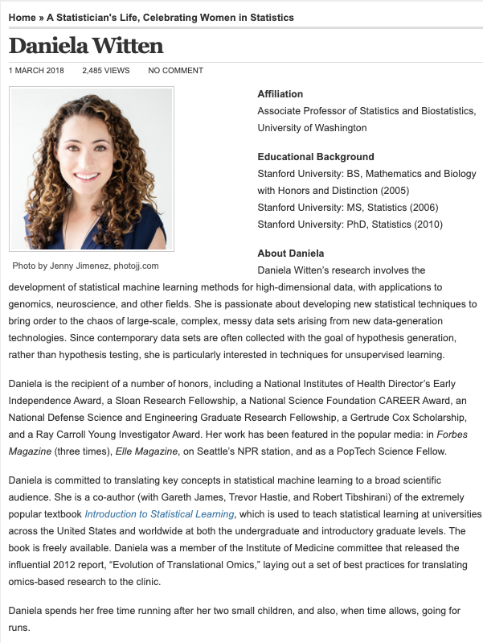
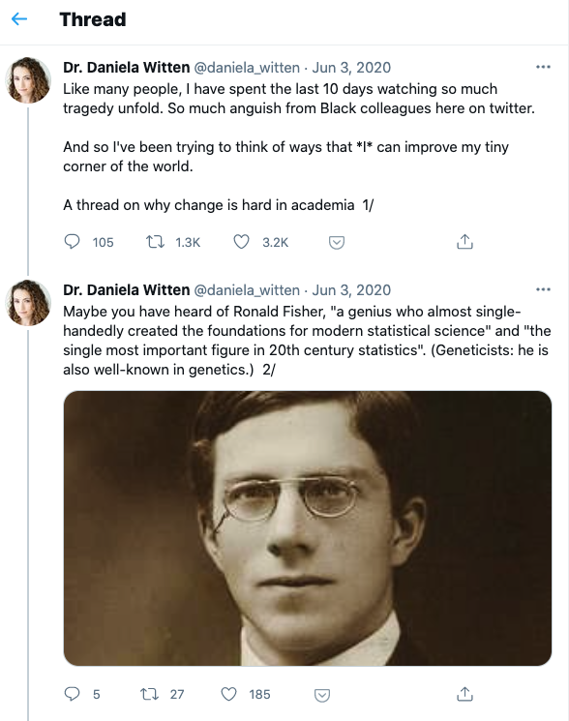
Notes:
And lastly, Dr. Daniela Witten is another quickly rising statistician in our field, and I wanted to highlight her because she has become a bit twitterfamous, I guess you might call it, and she used that influence as well as her service committments to the COPSS committee to lead the proposal to rename the Fisher prize recently. She fearlessly exposed herself to a lot of criticism by questioning publicly why we would honor someone who has a racist past, no matter how important his methodological contributions were. So I think this is a good example of working towards changing the culture and institutional racism and sexism and inequity in academia and statistics. It may seem a small thing to rename an award, but it helps us see that we should lift up people who are doing good for our community, amplify more diverse voices, and honor people that respect people from all backgrounds.

Slide 22
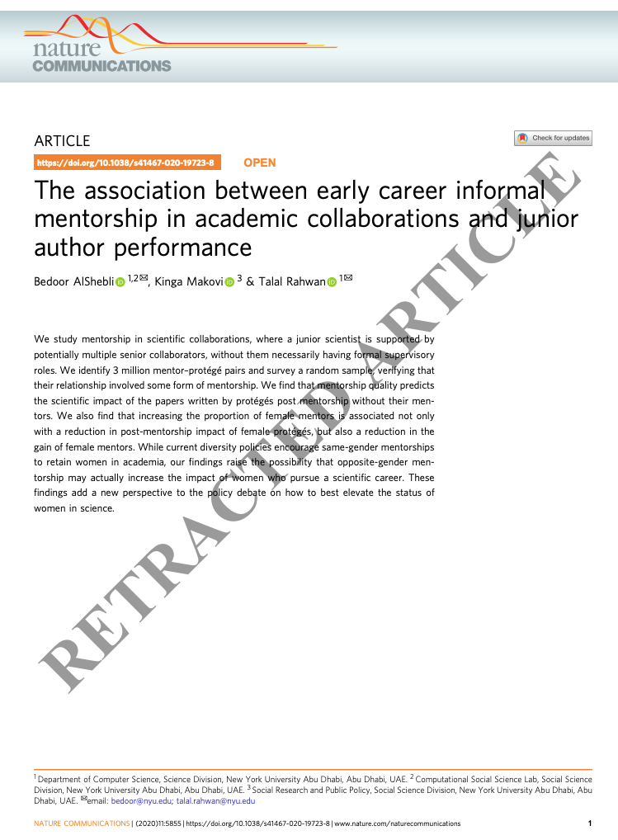
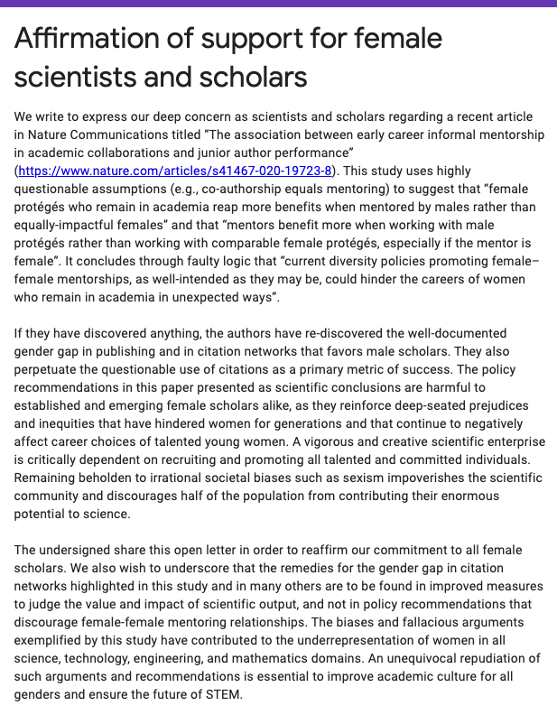
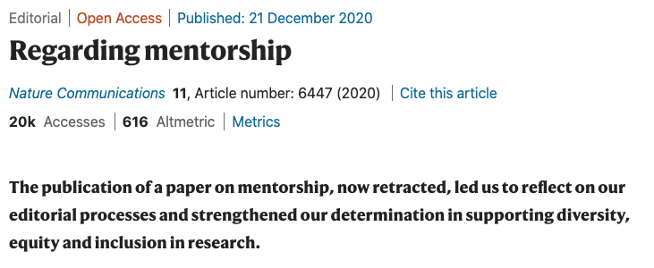
Notes:
I also felt like I couldn’t talk about women mentors without mentioning this recent controversy. There was a paper published in nature communications last December, that has since been retracted as you can see. The authors analyzed a database of scientific articles and publications, and tried to assess the success of researchers based on whether they had a female or male mentor. Their ultimate conclusions were that women who were mentored by men increased the impact of their career compared to women mentored by women.
There was a large outcry after this paper was published, with over 7000 people signing this petition to retract the paper. People pointed out flaws in the methodology, namely that the authors measured gender as a binary trait based on some algorithm that assigned names to male or female, which didn’t actually work that well and also importantly, gender is not actually binary. They also assessed mentorship by assigning the first author as the mentee and the last author as the mentor, and assessed impact of career essentially by number of citations. So there are a lot of big assumptions there. But in theory, the methodology wasn’t the huge problem, it was mainly I believe that the authors analyzed data that is generated from an inherently biased system where men have more opportunities than women, have access to citation networks and communities that women are shut out of, and so on. It’s telling us what we already know, that the academic publishing and promotion system is a bit broken. So I think the outcry was mainly the way the results were framed, that it was the female-male or female-female mentorship that was the problem causing the inequities. Essentially, correlation is not causation, and garbage in garbage out.
The authors and the journal later acknowledged the systemic barriers and implicit biases that influenced their results, but this goes to show that perspective is really important, and we have a lot of work to do to continue to fix these systems, and maybe we should be doing research on why this is happening.
----------
Calling the notion “absurd,” Miller said the results instead “point to systematic barriers and implicit biases faced by female researchers that can and should be addressed.” Beyond that, he said, the paper's definition of mentorship is essentially co-authorship and its definition of mentees' success -- number of citations on papers not authored with the mentor -- is “very narrow.”
Regarding how the researchers determined gender, Miller, said the authors admitted they couldn't determine a gender for 48 percent of the first names tested on Genderize.io, as these names were unclassified or unknown. That method also "erases trans and nonbinary people,” Miller added.
On gender, Isis said it’s “not a secret that men are cited more than women. It’s not a secret that there are factors that keep women from publishing (cough, COVID, cough). The quality of a scholar branches beyond a 5-year publication period. Teaching, grants, talks, translation to practice, and impact on people.”
Isis “would never have stayed in science were it not for my female mentors who demonstrated a quality and creativity of scholarship that extended beyond this lone index,” she continued. “To distill quality down to a single metric and diminish this important role of women mentors feels like a knife in the heart.”
Tania A. Reynolds, an assistant professor of psychology at the University of New Mexico, wrote on Twitter that “Many people are calling to have this paper retracted, but these findings are quite in line with extant work on female-female competition,” including the “queen bee” phenomenon. “If there is something undermining female-female mentorship,” she said, “we should investigate why.”
Over 7000 people signed this petition calling to retract the paper, and many prominent statisticians tweeted and wrote blog posts about the article. They spoke about the questionable assumptions, the poor methods for identifying female gender, and also the fact that any true associations found in theri studies merely emphasize the gender gap that we already know exists in publications and citation networks. There is no reason to discourage female-female or female-male mentoring relationships.

Slide 23
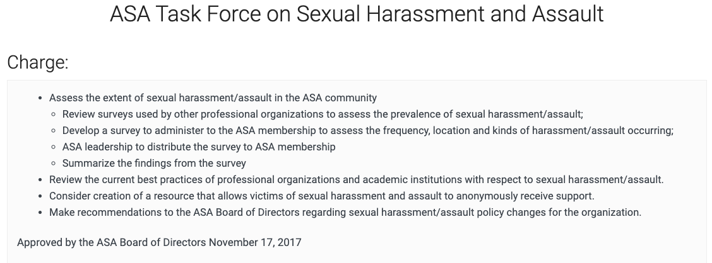
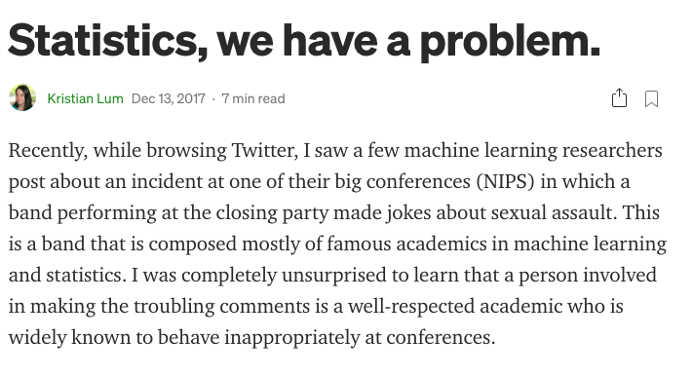
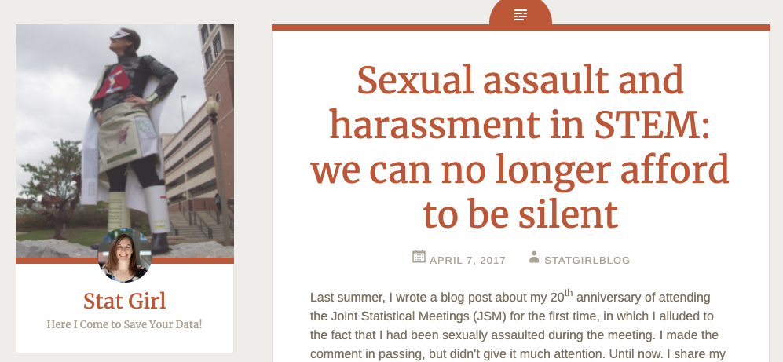
Notes:
There has also recently been a reckoning with the metoo movement that has been highlighted with rather horrifying stories by women in our field, related to experiences with sexism and sexual harrassment. I’ve found it interesting that this was a hot topic for a couple years but it has become a bit of old news now, so I hope the task force at ASA is continuing to improve conditions for women and underrepresented groups, because this is a prevalent problem that won’t go away overnight.

Slide 24
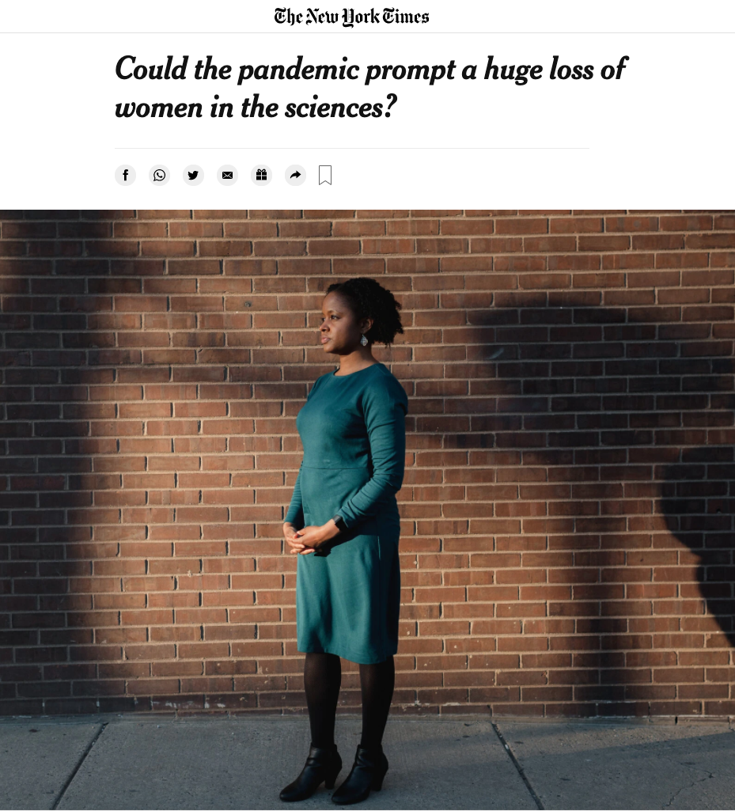
“Studies have found that women in academia have published fewer papers, led fewer clinical trials and received less recognition for their expertise during the pandemic.
Add to that the emotional upheaval of the pandemic, the protests over structural racism, worry about children’s mental health and education, and the lack of time to think or work, and an already unsustainable situation becomes unbearable.”
NYTimes, Apoorva Mandavilli, 2021-April-13
Notes:
And lastly, I think it’s important to discuss mentorship of women and underrepresented groups in statistics and the greater science community, now that we are at a kind of crossroads with this pandemic. We’ve seen how pandemic life has disproportionally affected women and their careers, with children home from school and childcare basically nonexistant. It’s ingrained into our culture, that women are the primary caregivers of the family, for kids and for aging parents, and it’s holding many of us back from fulfilling our dreams and, as we like to say, having it all. We need mentorship and also people to create the laws and social support systems that can make it a more fair distribution of opportunities and safety nets.
There was an article recently in the new york times that quoted several statisticians speaking about how hard it has been to keep working at the productivity levels that our field and society expect. Dr Daniela witten is quoted, as well as Dr Alisa Stephens who is photographed here, she’s an associate professor at Penn. This quote here highlights the challenges, where studies have found women in academia have published fewer papers, led fewer clinical trials, and received less recognition for their expertise during the pandemic. Adding to that, the emotional burdens of the pandemic, structural racism, and worry about children’s mental health and education, with a lack of time to think or work, and an already unsustainable situation becomes unbearable.” So I hope this highlights the change that still needs to come.

Slide 25
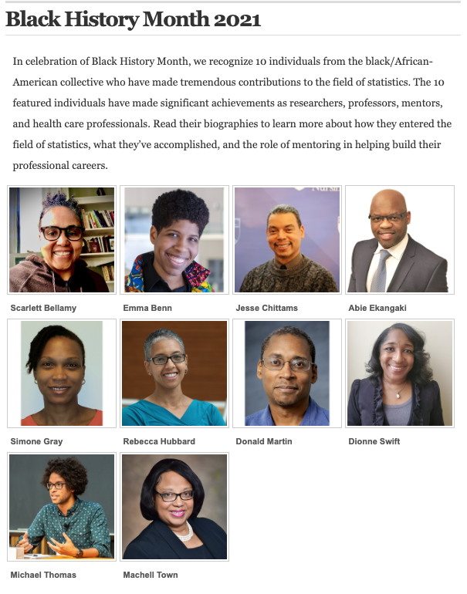
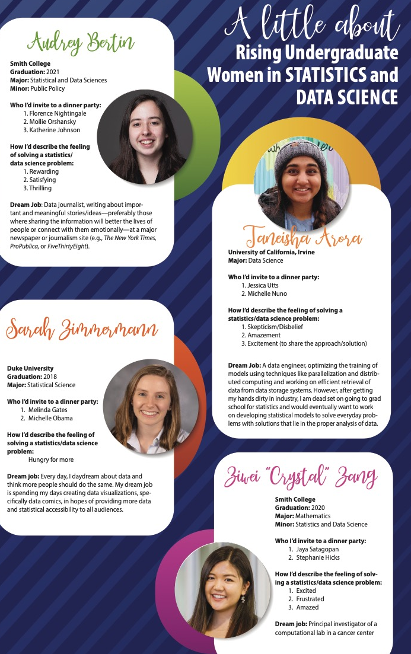

Notes:
But I don’t want to end on a negative note, so I’ll bring back a slide of just a small subset of inspiring statisticians who are increasing the inclusivity and representation in statistics, and opening doors for the rest of us to follow. And here on the right is a nice blurb about some rising junior statisticians, who I’m sure have some excellent mentors helping them find their way through their careers. I liked that their dinner party selections included Michelle Obama, Jessica Utts former ASA and CWS president, and Florence Nightingale herself.

Slide 26

Thank You
Notes:
And that’s all I have, thanks for listening, and I hope you learned a something new about the influential statisticians of history and of our time.

